Slide 1
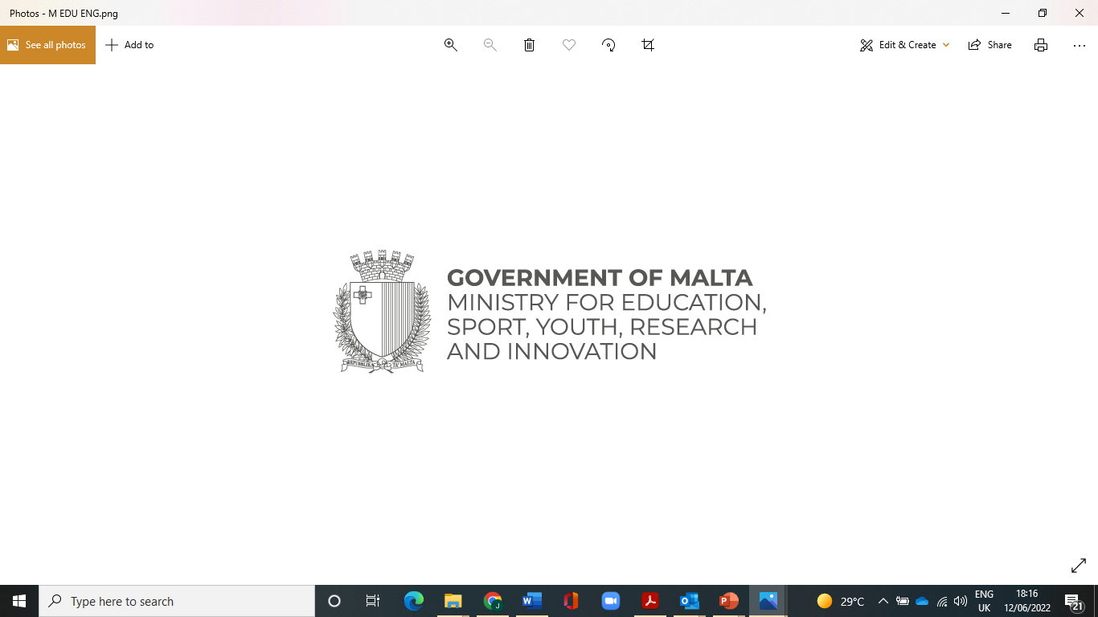

Foreign Languages Grants scheme

Slide 2

Aim:
The Ministry for Education, Sport, Youth, Research and Innovation (MEYR) is committed to provide young people aged 14 to 30 years old with the possibility to follow language training in the respective native country with the launch of Live the Language (LTL) scheme .

Slide 3
Choice Of Language Training Programme
Arabic
French
Irish
Italian
Swedish
German
Spanish
Latin
Russian
Chinese (Mandarin)
Any other language not generally taught in the educational system will be available for application.

Slide 4
Each grant has a maximum value of €850.
The grant will be paid Pro-rata on the presentation of the receipts.
This scheme will remain open until funds are exhausted.

Slide 5
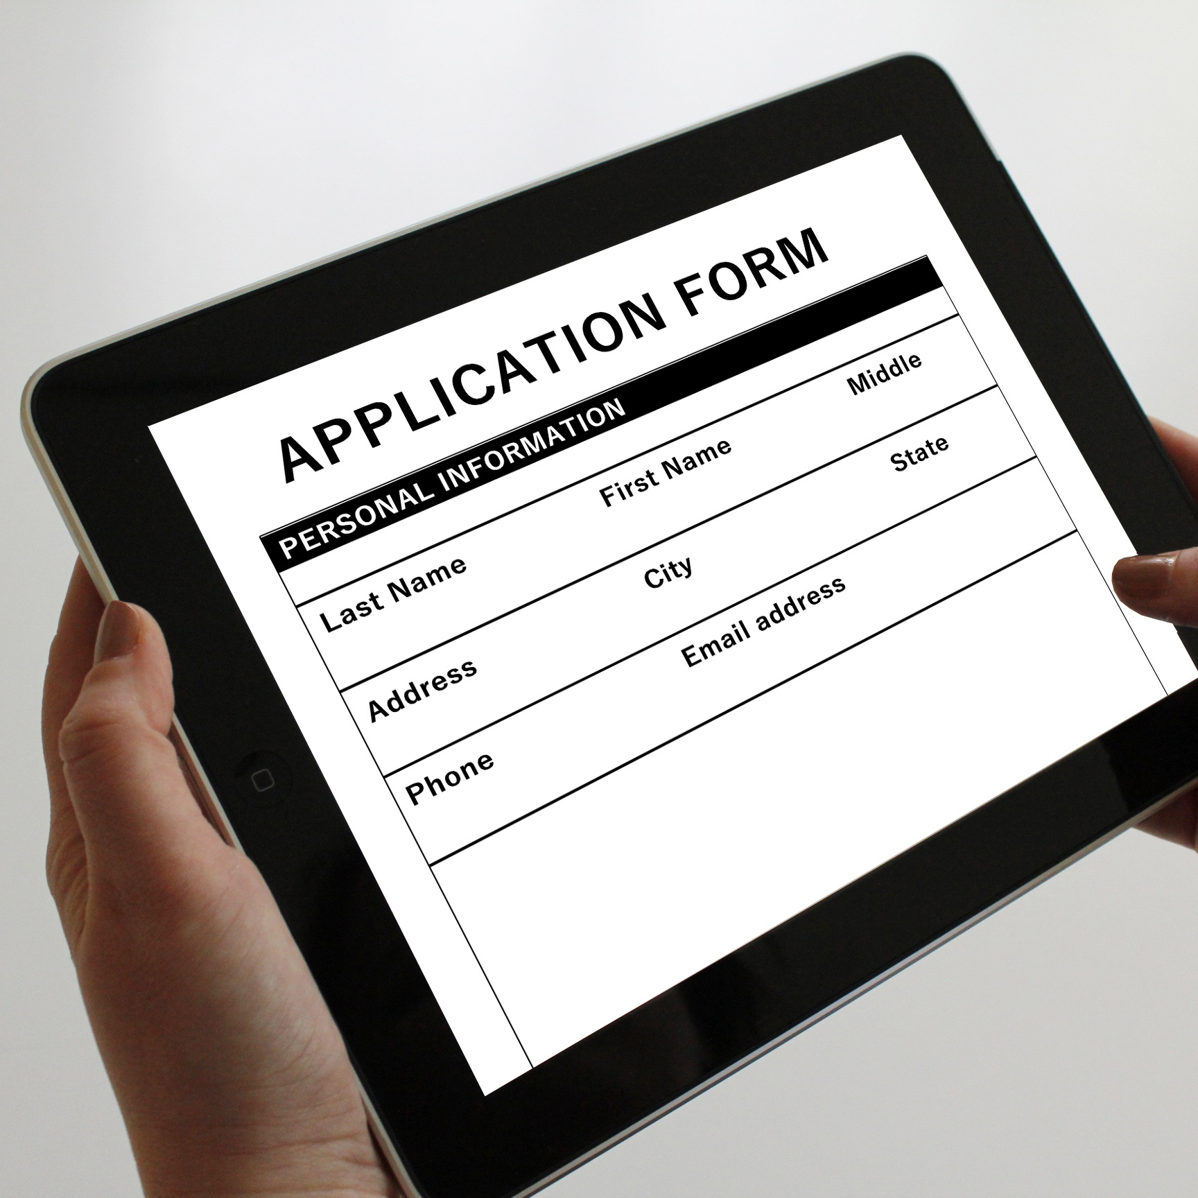
Application forms:
Applications are only accepted online.
Application forms are to be submitted once course is completed and by not later than 3 months of the course completion date.

Slide 6
Supporting documentation for online application & Eligible Costs

Slide 7

Training Programme Fees
Shall be those charged directly by the recognised institution
This is to include:
Course Fees and any required course resources

Slide 8

Accommodation Expenses
Accommodation receipts must be addressed to the applicant, parent or legal guardian and must include the applicant check in and check out dates.
A maximum of 2 additional nights are covered, one day before the training programme and one day after the programme.

Slide 9

Flight Ticket/ Boarding Pass
Flight dates are to be in line with course programme.
Any other travel related expenses such as bus, taxi, metro etc. are not covered.

Slide 10

Certificate of Attendance/Award
To include:
Name of Applicant
Date when Issued
Name of Course
Start and End date of Course
Number of hours attended (minimum 15 hrs)

Slide 11


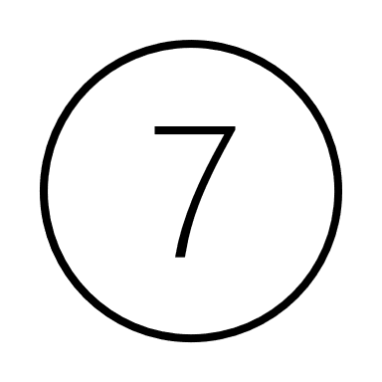
Financial Identification Form (TR/S-9)
Consent Form (for parent or legal guardian)
Data Protection Form
The above forms can be found on the scholarship website https://education.gov.mt/myscholarships/ , click on Live the Language.
Fill in forms in blue ink and submit with the rest of the documents

Slide 12
Important Points!
Language training programme must be of, at least 15 hours
Online language courses are not covered under this scheme.
Applicants may apply for any level of a training programme.
Applicants may apply for the next course 3 months after the last course is completed.
Minors under the age of 18 years can only participate with the consent of their parents or legal guardians.

Slide 13
Eligibility and Procedures
The MEYR has appointed the LTL Board to operate the process of eligibility. This Board shall be responsible for all matters concerning the application process.
Applicants shall become ineligible for a Grant if they are in breach of any part of the Regulations.

Slide 14
Ltl REGULATIONS
Prospective applicants are advised to review the Regulations found on the scholarship website https://educationservices.gov.mt/en/education/myScholarship/Pages/Live-the-Language.aspx
carefully before proceeding with the application.

Slide 15

Information
For further queries and information please contact:
Scholarships Unit
Room 116
Ministry for Education, Sport, Youth, Research and Innovation
Great Siege Road
Floraina VLT2000
Malta
Tel. No. (+356) 25982678
E-mail: livethelanguage.meyr@gov,mt
Website: www.myscholarship.gov.mt

Slide 16
THANKS!
Any questions?
You can contact us on livethelanguage.meyr@gov.mt

